Slide 1
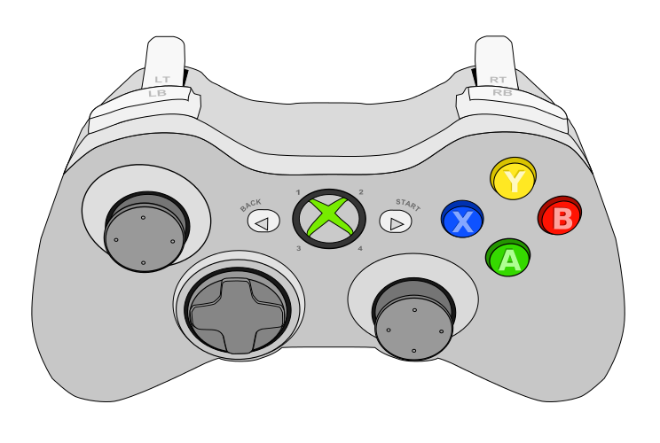
Controller 1
Drive Forward
Strafe Left
Strafe Right
Drive Back
Turn Left
Turn Right

Slide 2
Controller 2
Split Boxes Out
Suck Boxes In
Lower Box Collector
Raise Box Collector
Lower Robot
At Same Time
Raise Robot

Slide 3
Controller 1 for Both
Split Boxes Out
Suck Boxes In
Lower Box Collector
Raise Box Collector
Drive Forward
Lower Robot
At Same Time
Raise Robot
Strafe Left
Strafe Right
Drive Back
Turn Left
Turn Right

